Slide 1
IEEE STD 830-1998 ACADEMIC SPECIFICATION
| B.Tech Final Baseline
BankEase – NextGen Net Banking System
Full-Stack Academic Net-Banking Simulation Platform Built with Angular, Spring Boot REST Architecture, and MySQL
SUBMITTED BY
INSTITUTION
Ujjwal Upadhyay
Dept. of Computer Science & Engineering
Roll No: 2400320101205
ABES Engineering College, Ghaziabad (2026–2027)

Slide 2

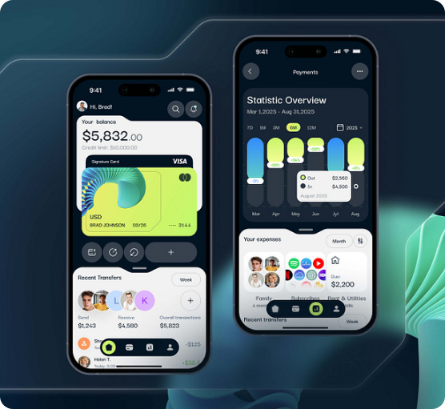
SYSTEM SCOPE & OBJECTIVES
Project Purpose & Capabilities
Centralized Banking Simulation
Provides authenticated customers with core personal banking workflows through secure APIs and responsive UI.
In-Scope Capabilities
JWT authentication, savings/current accounts, IMPS/NEFT/RTGS transfers, bill payments, loan processing, and investment catalogs.
Explicit Boundaries
Self-contained database simulation. Excludes live payment gateway settlement, ATM processing, or external core-banking links.

Slide 3



ARCHITECTURE & TECH STACK
Multi-Tier Stack Composition
PRESENTATION TIER
APPLICATION API TIER
PERSISTENCE TIER
Angular 20.3 UI
Spring Boot 4.1.0
MySQL Storage
Standalone component architecture with TypeScript ~5.8, RxJS streams, route guards, and HTTP interceptors.
Java 21 REST API backend with Controller-Service-Repository pattern, DTO mappers, and Spring Security.
Spring Data JPA / Hibernate persistence layer managing relational schemas, BCrypt hashing, and audit logs.

Slide 4
ROLE-BASED ACCESS CONTROL
User Personas & Hierarchy
Administrator
Registered Customer
Guest / Visitor
High technical proficiency.
Intermediate proficiency.
Basic proficiency.
•
Review user directory list.
•
Create savings/current accounts.
•
Access public registration.
•
Update customer KYC status.
•
Manage active beneficiaries.
•
Authenticate via login API.
•
Enable or disable user accounts.
•
Execute transfers & pay bills.
•
Browse public investment products.
•
Approve loans & set interest.
•
Apply for loans & investments.
•
Restricted from banking APIs.

Slide 5
SECURITY & SESSION MANAGEMENT
Module 1: Authentication Pipeline
01
02
03
04
BCrypt Hashing
JWT Generation
Route Protection
Audit Logging
Validates unique email and 10-digit mobile pattern before encoding password.
Issues signed HS256 Bearer JWT upon Spring Security authentication.
Restricts administrative endpoints (/api/admin/**) strictly to ADMIN roles.
Persists success and failure events into AuditLog with global exception handling.

Slide 6
MODULE 2: BANKING OPERATIONS
Fund Transfer Modes & Rules
Transfer Mode | Transaction Limits | Prerequisite Rules
IMPS Mode | Capped at ₹5,00,000 per transaction | Active source account with sufficient balance
NEFT Mode | Standard clearance mode | Active beneficiary with verified IFSC code
RTGS Mode | Requires minimum ₹2,00,000 threshold | High-value real-time transfer validation
Daily Cap | Max ₹2,00,000 cumulative transfer limit | Customer KYC status must be VERIFIED
Validation Enforcement: Non-verified KYC users or accounts with insufficient balances are automatically rejected by business validation services.

Slide 7
Transactional Data Integrity
100%
Atomic Balance Update & Rollback Guarantee
All money-moving fund transfers, bill payments, and investment redemptions run inside transactional boundaries with automatic exception rollbacks.

Slide 8


MODULE 3: WEALTH & CREDIT SERVICES
Loans & Investment Products
Loan Processing Engine
Investment Portfolio
•
Loan Categories: Personal, Home, Education, and Vehicle loans.
•
Product Catalog: Publicly viewable Fixed Deposits, Mutual Funds, and Bonds.
•
Application Rules: Minimum ₹10,000 threshold; tenure spanning 6–360 months.
•
Purchase Rule: Validates minimum investment, active status, and account balance.
•
Admin Approval: Assigns interest rate and triggers backend EMI calculation.
•
Redemption: Credits current value directly back to the original funding account.

Slide 9
ADMINISTRATION & GOVERNANCE
Admin Control & KYC Workflow
STEP 1
STEP 2
STEP 3
KYC Lifecycle
User Toggle Control
Loan Decisioning
Reviews registered customer profiles and updates status between PENDING, VERIFIED, or REJECTED.
Enables or disables user account access instantly via administrative REST endpoints.
Inspects pending loan queue, sets approved interest rate, or issues rejection decisions.

Slide 10
QUALITY METRICS & NFRs
Non-Functional Requirements
Security & Encryption
Reliability & Integrity
BCrypt password encoding, stateless Bearer JWT, and strict RBAC authorization guards.
Transactional database rollback boundaries with persistent event audit logs.
Maintainability
Usability & Portability
Decoupled Controller-Service-Repository architecture using DTO mappers.
Responsive Angular SPA interfaces running on standard browsers with Java 21 / MySQL backend.

Slide 11


SYSTEM ANALYSIS & DIAGRAMS
UML Graphical Models
Use Case Diagram (Figure 3)
Maps Guest, Customer, and Administrator actors to core platform workflows.
Context Diagram (Figure 1)
Illustrates Level-0 Angular client REST communication with Spring Boot and MySQL.
Entity-Relationship Model (Figure 4)
Crow's Foot model defining User, Role, BankAccount, Beneficiary, Transfer, and AuditLog.
Sequence Diagram (Figure 5)
Chronological flow for fund transfer execution from UI through API to DB.

Slide 12
ACADEMIC REVIEW & EVALUATION
BankEase SRS Baseline Approved
Software Requirements Specification verified for 3rd-Year B.Tech Computer Science & Engineering project evaluation.
PROJECT COORDINATOR
INTERNAL EXAMINER
HEAD OF DEPT (HOD)
Signature: ____________
Signature: ____________
Signature: ____________
Date: 30-Sep-2026
Date: ____________
Date: ____________

Slide 13


Image Sources
https://cdn.dribbble.com/userupload/44735659/file/a7fbae61b9fddeb20c8c897c9b7519b5.jpg?resize=752x&vertical=center
Source: dribbble.com
https://www.toshiba-clip.com/en/wp-content/uploads/sites/2/2023/04/img_1_Main_Image_Clip_article-Building_a_quantum-secure_future.jpg.jpeg
Source: www.toshiba-clip.com

